Slide 1
Lecture 16
Machine Learning and Intro to Scikit Learn

Slide 2
Learning Objectives Today
Machine Learning
Machine Learning Categories
SciKit Learn
Linear Regression
Dimensionality Reduction
Clustering

Slide 3
Machine Learning
Machine learning (ML) is a branch of artificial intelligence (AI) that focuses on the development of algorithms and statistical models that allow computers to perform tasks without being explicitly programmed to do so. In essence, it enables systems to learn from and make decisions based on data.
Fundamentally, machine learning involves building mathematical models to help understand data.
“Tuneable” parameters

Slide 4
Categories
Supervised
Classification
Regression (Continuous Prediction)
Unsupervised
Clustering
Dimensionality Reduction

Slide 5
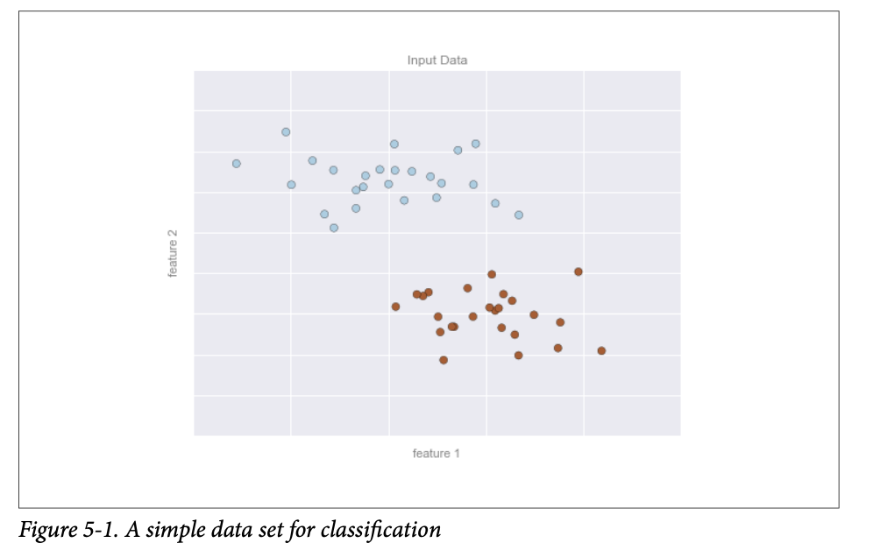
Classification
Example: Spam Email Detection?

Slide 6
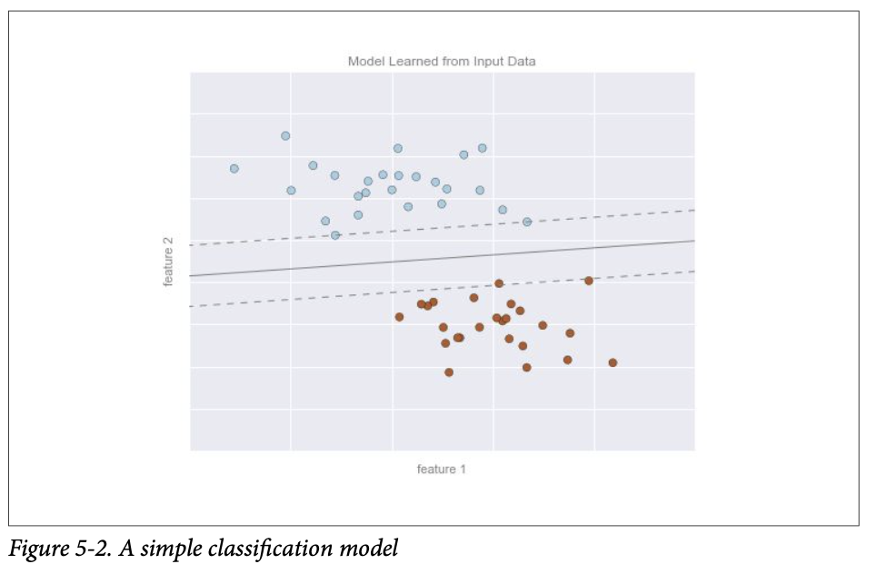
Classification Model

Slide 7
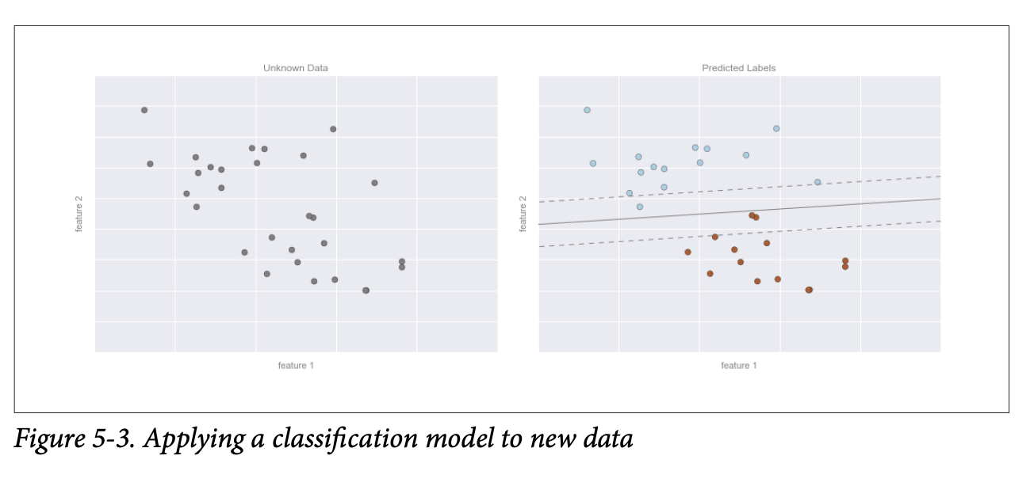
Supervised Adjustment

Slide 8
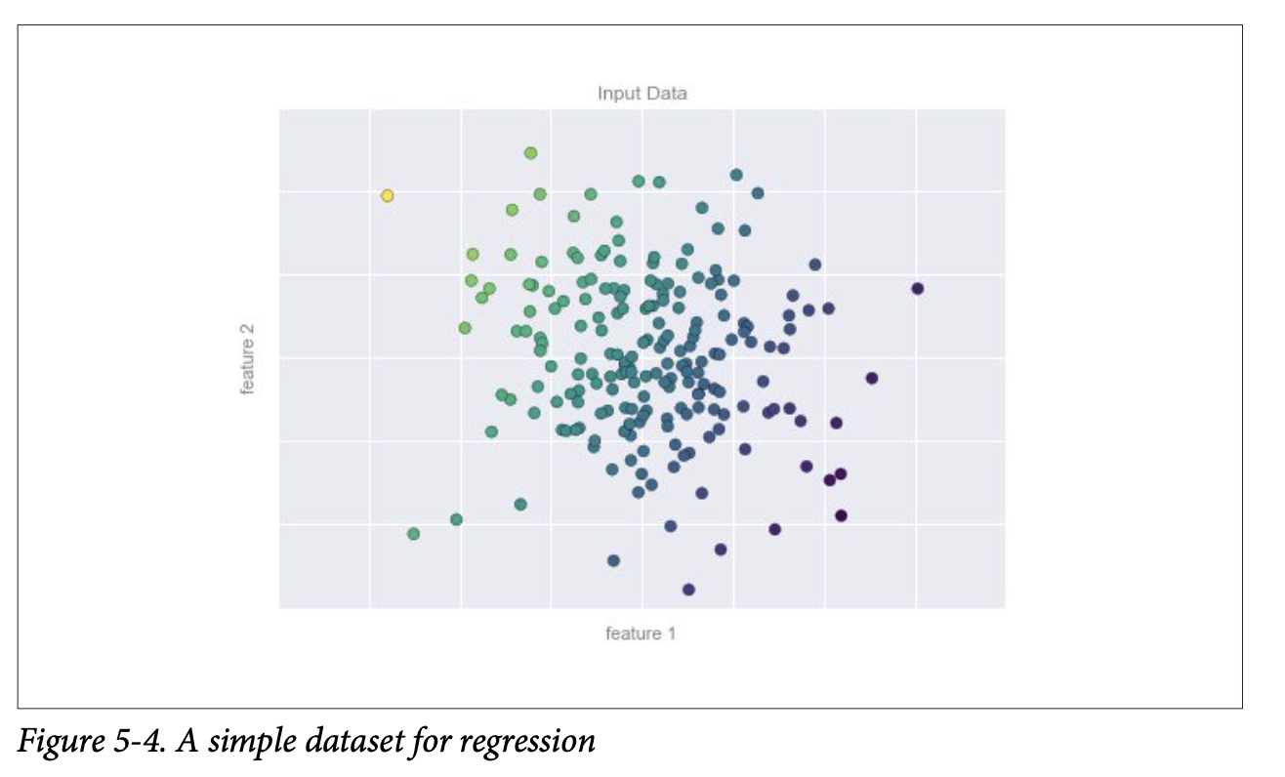
Regression (Predicting Continuous Label)

Slide 9
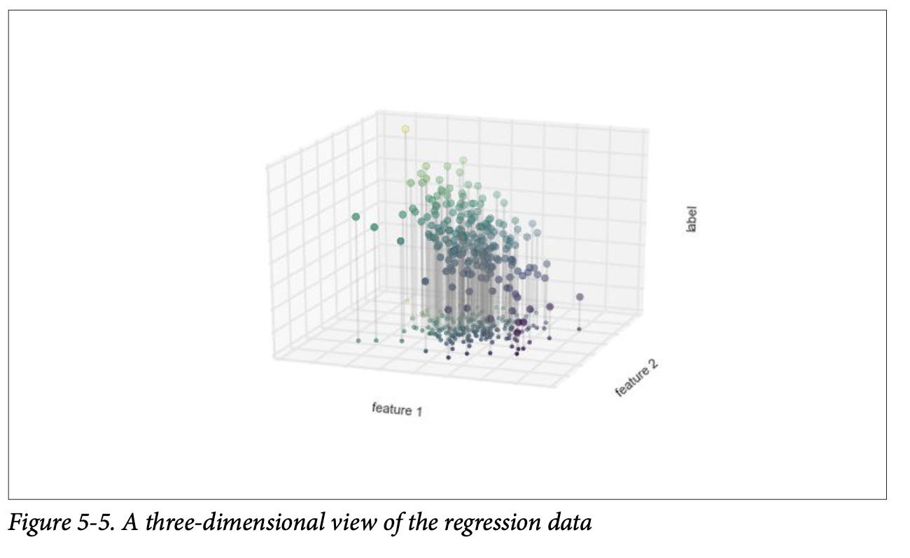
3d View of Data

Slide 10
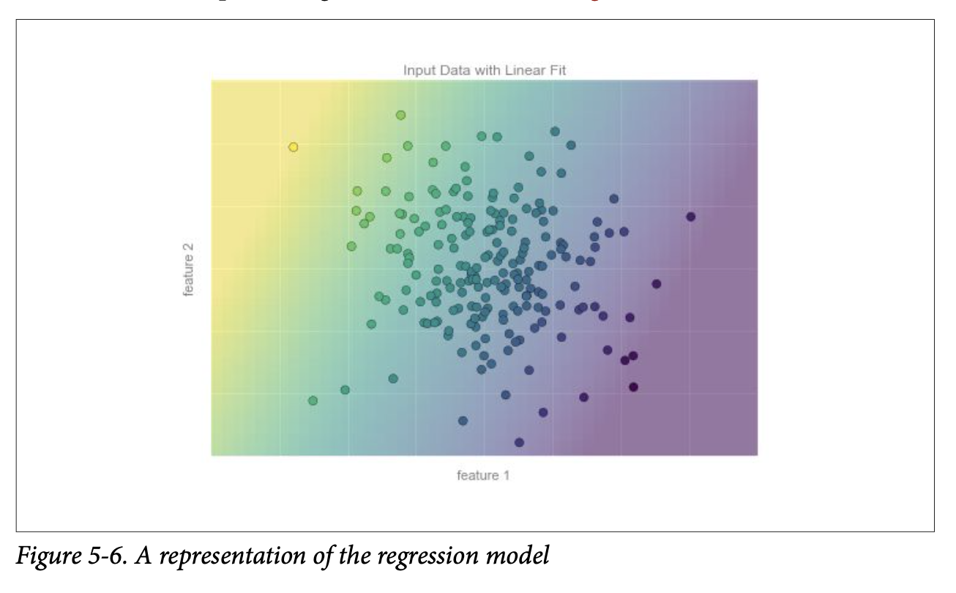
Regression Model
Example: Brightness of a galay

Slide 11
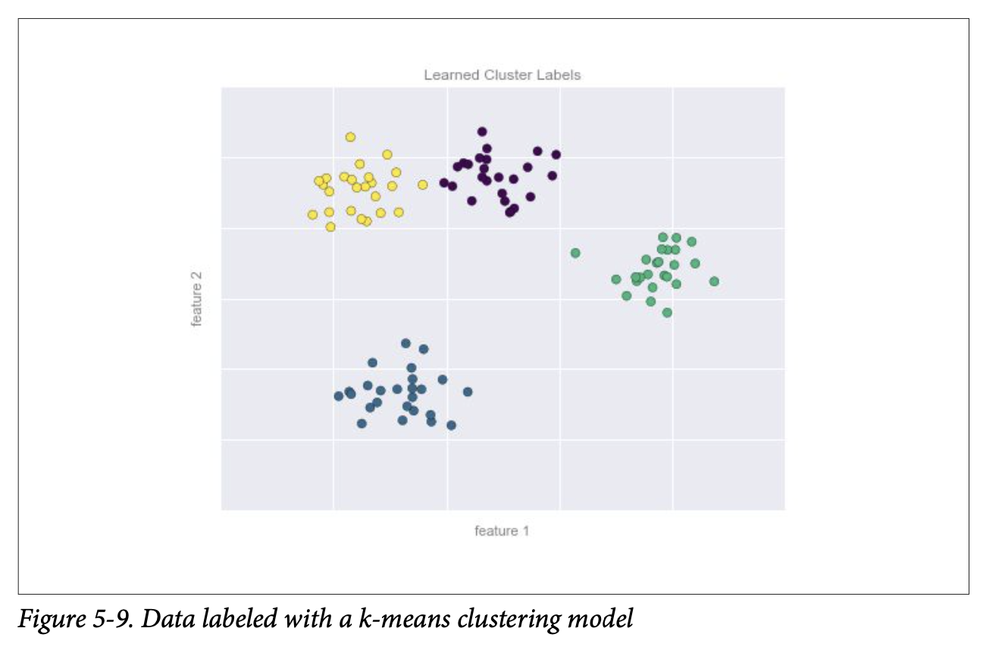
Clustering

Slide 12
K-means Clustering
https://halderadhika91.medium.com/k-means-clustering-understanding-algorithm-with-animation-and-code-6e644993afab

Slide 13
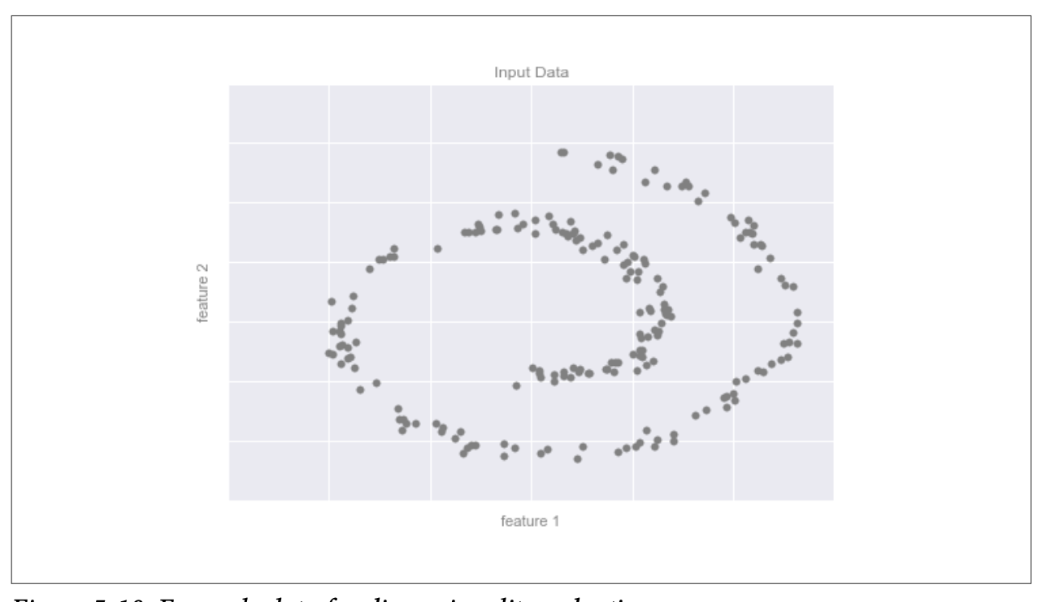
Dimensionality Reduction

Slide 14
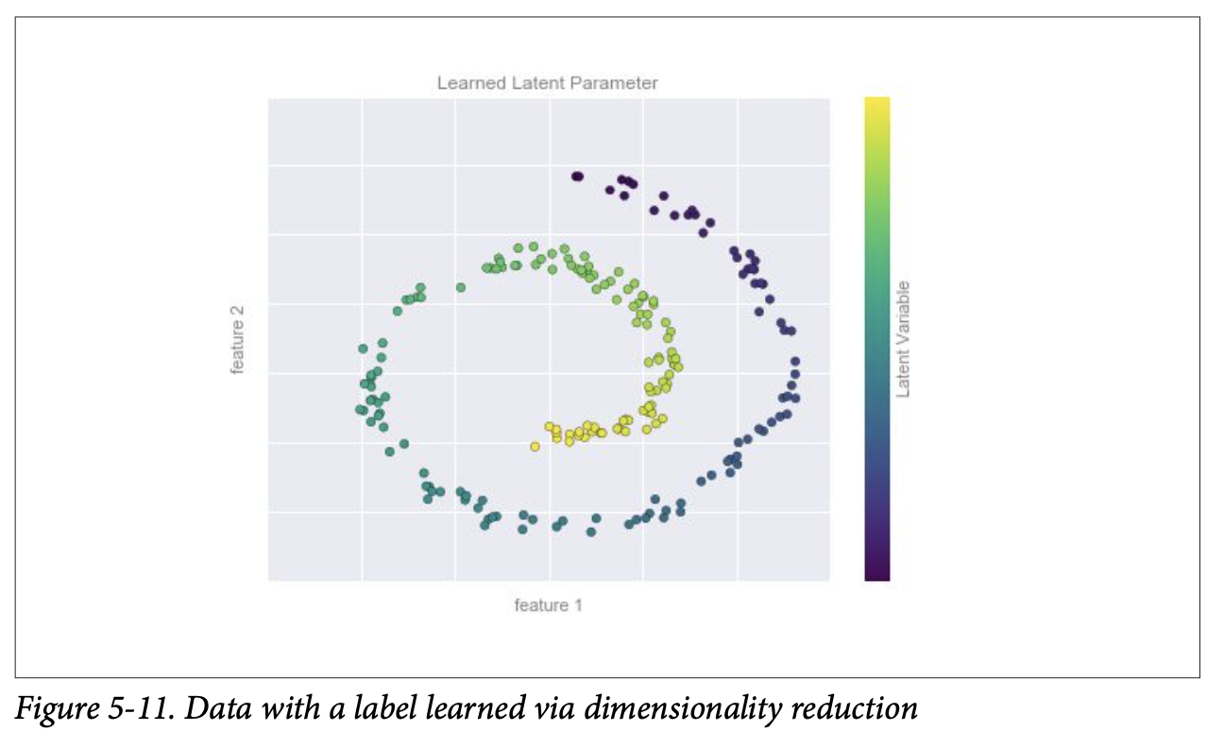
Manifold Learning – Dimensionality Reduction

Slide 15
Task To Do
Can you find out examples to match these categories? Search or Think of some examples.

Slide 16

SciKit Learn

Slide 17
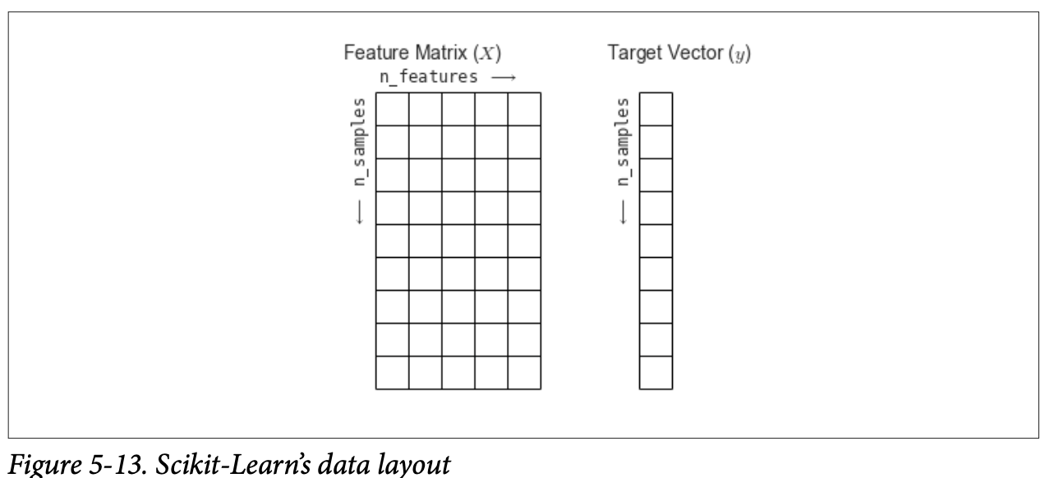
SciKit Learn
Before that
[n_samples, n_features]
Target ”y” / Dependent variable

Slide 18
Separate Feature Matrix and Target Array
X_iris = iris.drop('species', axis=1)
y_iris = iris['species']

Slide 19
Basic Steps for SciKit Learn
Choose a class of model by importing the appropriate estimator class from Scikit- Learn.
Choose model hyperparameters by instantiating this class with desired values.
Arrange data into a features matrix and target vector following the discussion from before.
Fit the model to your data by calling the fit() method of the model instance.
Apply the model to new data:
For supervised learning, often we predict labels for unknown data using the predict() method.
For unsupervised learning, we often transform or infer properties of the data using the transform() or predict() method.

Slide 20
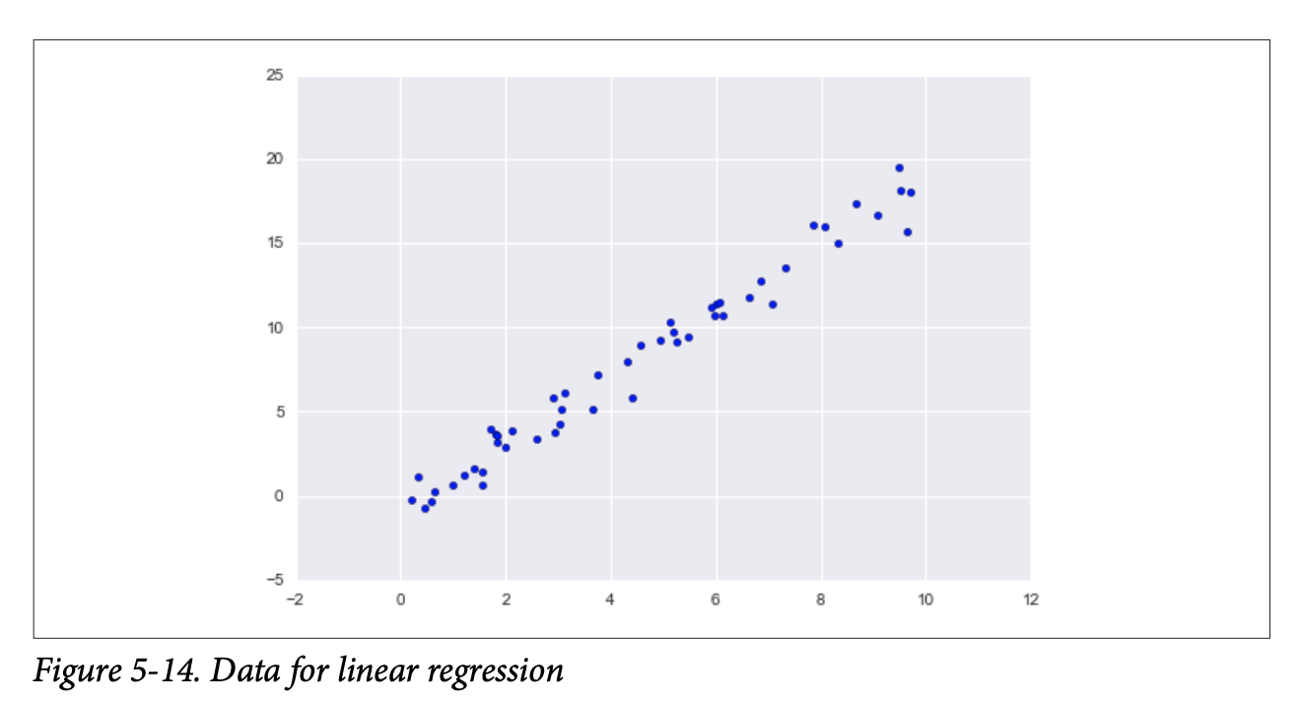
Linear Regression with SciKit
from sklearn.linear_model import LinearRegression

Slide 21
How many model components would we like to use?

Slide 22
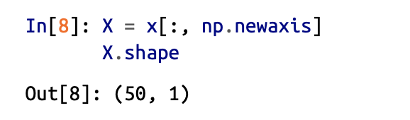
Array Shape for Linear Regression
Check Lecture16_Scripts1.ipynb for more details

Slide 23
Linear Rigression
model.fit(X, y)
yfit = model.predict(Xfit)
Check Lecture16_Scripts1.ipynb for more details

Slide 24
Scikit Learn for Classification
from sklearn.model_selection import train_test_split
Xtrain, Xtest, ytrain, ytest = train_test_split(X_iris, y_iris, random_state=1, test_size=0.10)
from sklearn.naive_bayes import GaussianNB
model = GaussianNB()
model.fit(Xtrain, ytrain)
y_model = model.predict(Xtest)
Check Lecture16_Scripts2.ipynb for more details

Slide 25
Dimenionality Reduction
Check Lecture16_Scripts4.ipynb for more details

Slide 26
Clustering Example
Check Lecture16_Scripts4.ipynb for more details

Slide 27
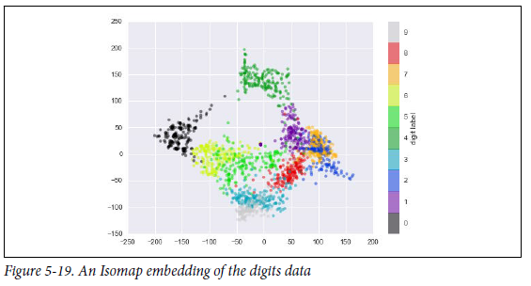
Image Data in SciKit Learn
Check Lecture16_Scripts5.ipynb for more details

